Slide 1


Frontend-Backend connection

Slide 2
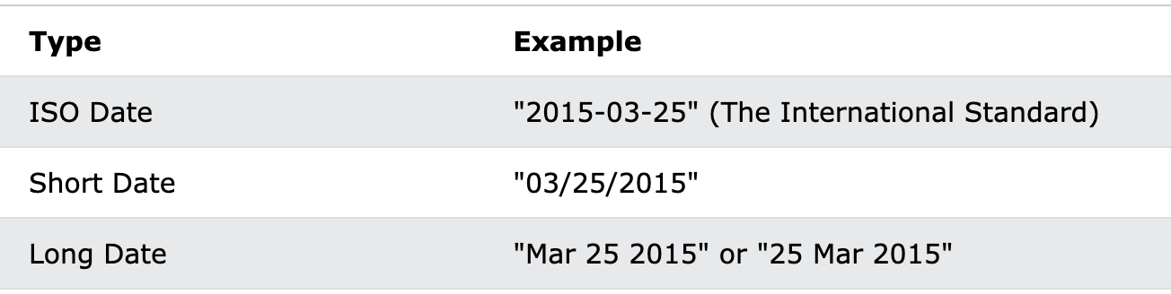
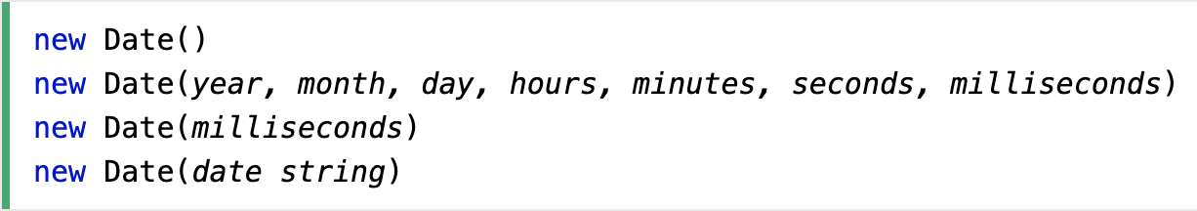
Date object

Slide 3
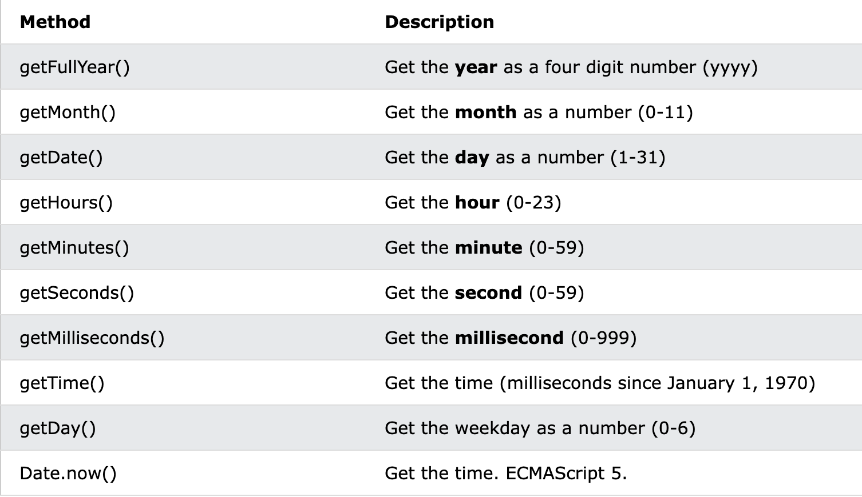

Slide 4
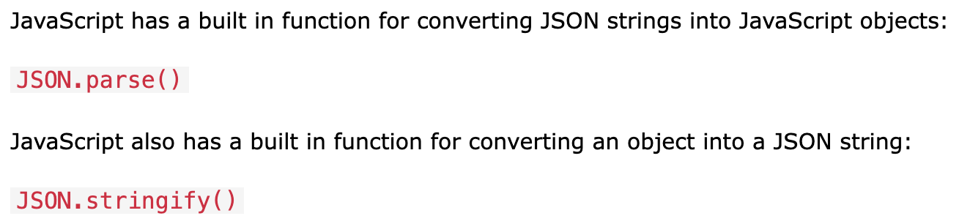
JSON
JSON (JavaScript Object Notation) is a lightweight data-interchange format. It is easy for humans to read and write.
'{"name":"John", "age":30, "car":null}'

Slide 5
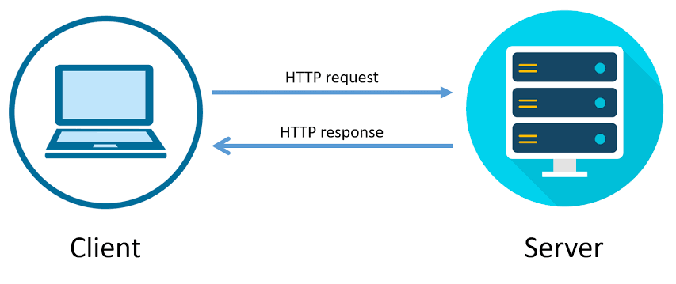
Hypertext Transfer Protocol Secure (HTTPS) is an extension of the Hypertext Transfer Protocol (HTTP).
It is used for secure communication over a computer network.

Slide 6
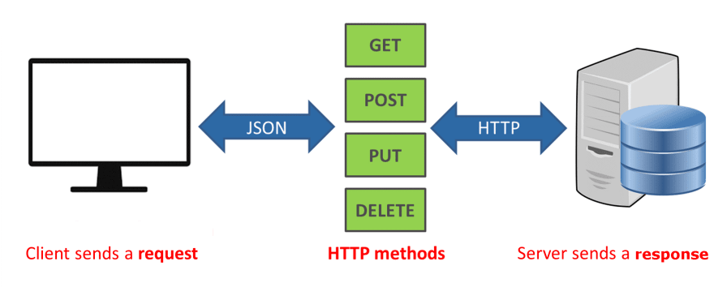
HTTPS Methods

Slide 7
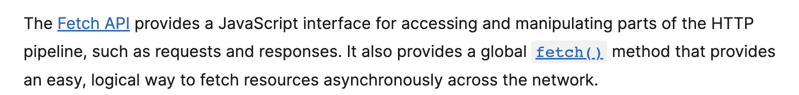
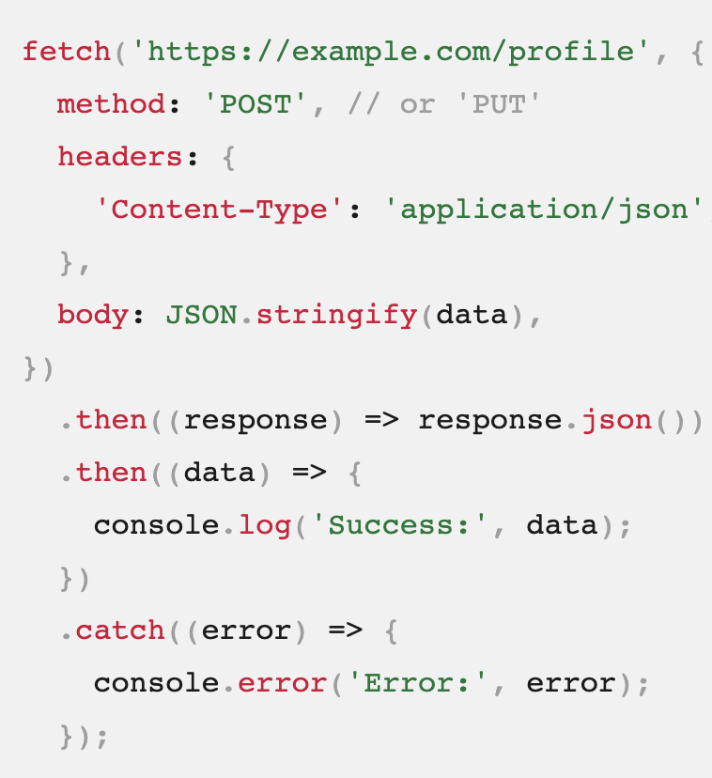
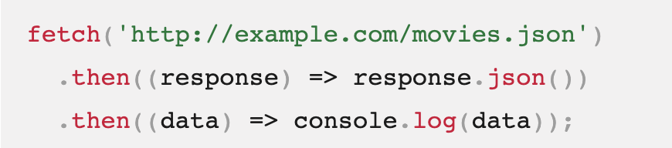
Fetch API

Slide 8
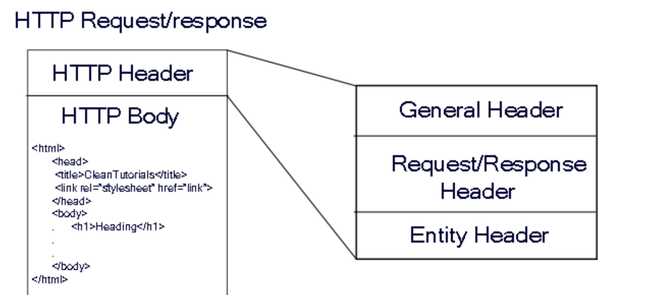
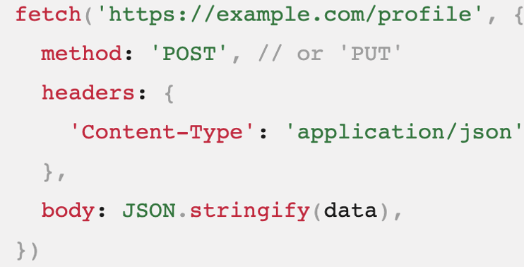
Send Data using Body
Query

Slide 9
Public API-s
https://randomuser.me/api. Get Random User
https://random.dog/woof.json Random Dog Image Generator
http://universities.hipolabs.com/search?country=United+Kingdom. Get Universities based Country

